Slide 1
PC503: Programming Lab
Prof. Shruti Bhilare

Slide 2
Course Evaluation Policy
Lab Assignments: 30%
Project work: 40%
Exams: 30%

Slide 3
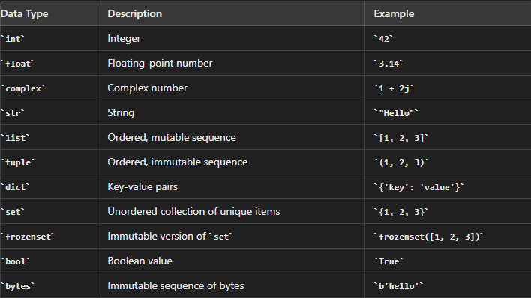

Slide 4
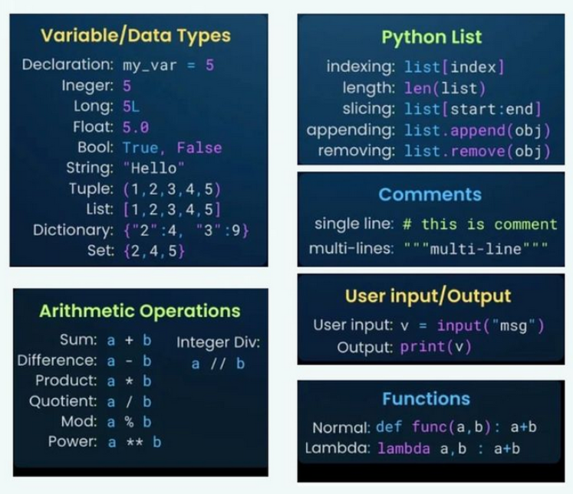

Slide 5
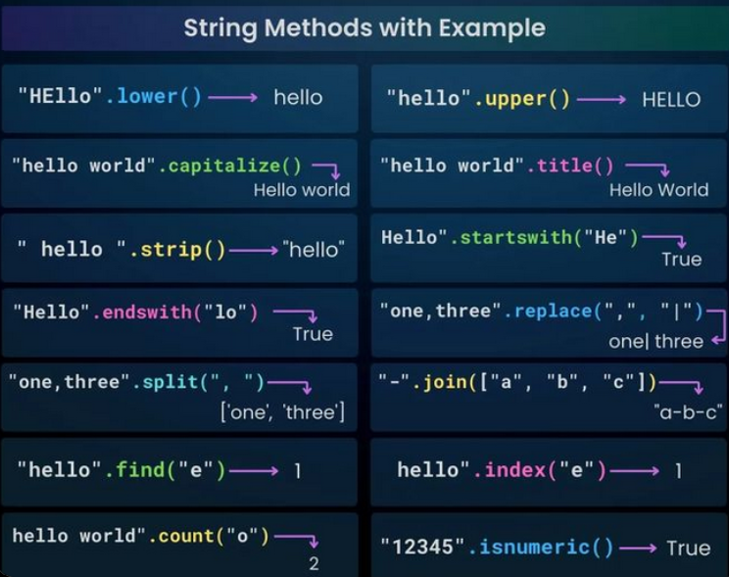

Slide 6
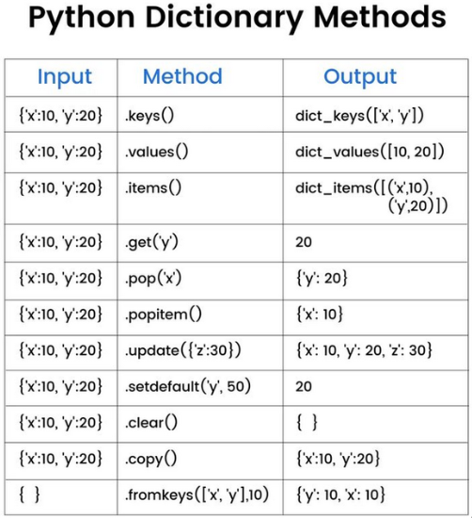

Slide 7
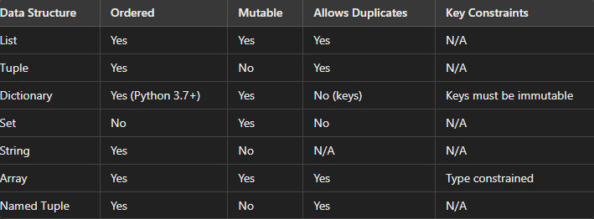
Summary of data structures

